Slide 1


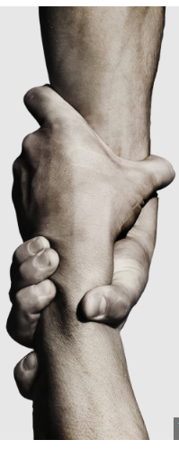

The Vision
Our Story

Slide 2


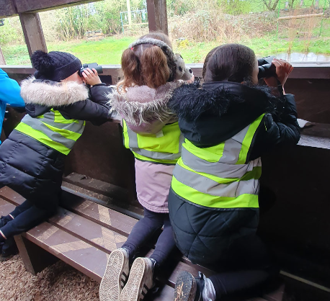
As a staff team, alongside parents and children we discussed what we felt represented our schools and community.
WHAT DO OUR SCHOOLS NEED to flourish?
Opportunities
Nurture
Aspirations

Slide 3

School community consulted and vision agreed.
Ask… and it will be given to you;
Seek… and you will find.
Knock… and the door will be opened to you. Matthew 7:7
Our vision
Ask… and it will be given to you;
Seek… and you will find.
Knock… and the door will be opened to you.
Matthew 7:7

Slide 4
Respect
What Values do we want our children to follow?
Which best fit in with our vision?
Responsibility
Unity
Ask… and it will be given to you;
Seek… and you will find.
Knock… and the door will be opened to you.
Matthew 7:7
Hope
Strength
Kindness

Slide 5
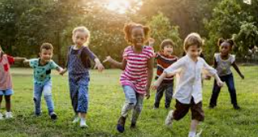
Living the vision
Children
Actively asking questions in lessons.
Reflective times to seek out what they need to find.
Opportunities given to them library leaders, school council, sports leaders.
School trips to widen learning opportunities.
Visitors to come and see the children from a wide range of cultures.
Well being high and children happy to come to school (pupil voice collected).

Slide 6

Living the vision
staff
Well being has improved.
Staff asking and seeking out opportunities to improve.
Courses provided and additional training to open new doors.
Staff consulted on what is happening and given opportunities to have a voice and share new ideas.

Slide 7
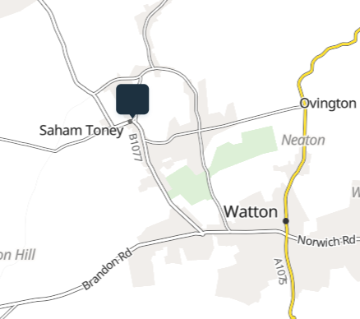
Living the vision
Within the community
Forming established links with church regular visits.
Setting up Stay and Play sessions reaching out to young mum’s in the community.
Parents visiting school to take part in their children’s learning.
Strong links with the Friends of the school. The community supporting with prizes and holding events that the children are invited to.
Developing outside area to enable more doors to be opened for the children.

